Slide 1

Code Rafactoring and bug fixing

Slide 2
Objective : Fix issues in the Note Taking Application's Python, Flask, and HTML codebase. Summary of bugs and solutions:
Form Submission: Corrected form action to "/".
Flask Route: Changed "method" to "methods".
Form Handling: Added logic for GET and POST requests.
Form Method: Specified HTML form method as "POST".
Security: Advised implementing XSS prevention measures.
Bug Fixed : Incorrect Request Method Handling in Flask
Original Issue : The Flask route only handled POST requests, resulting in a method not allowed error during initial page access.
Solution : Updated the Flask route to allow both GET and POST methods using methods=["GET", "POST"]. This change enables the application to handle all types of requests effectively.

Slide 3
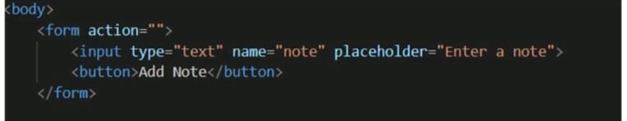
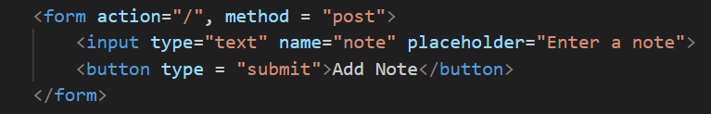
Incorrect Form html Method:
Original Issue : The HTML form tag did not include the method attribute, defaulting the method to "GET." This caused problems when submitting the form to add notes.
Solution : Added method="post" to the form tag to ensure the form data is submitted using the POST method, crucial for handling note additions.

Slide 4
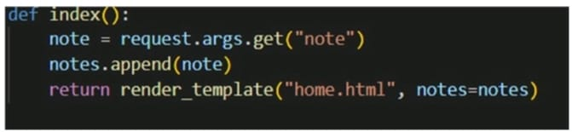
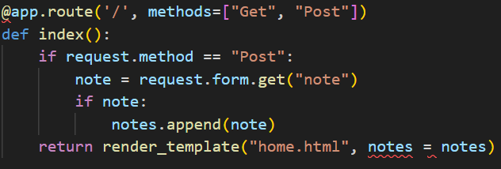
Incorrect Retrieval of Note in Flask Route:
Original Issue : The code used request.args.get("note") to retrieve notes from the form, suitable for GET requests but not for forms submitted via POST.
Solution : Updated the note retrieval code in the Flask route to use request.form.get("note"), ensuring proper handling of note submissions via POST requests.

Slide 5
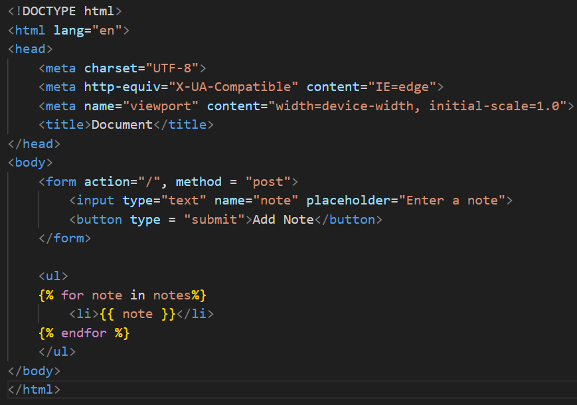
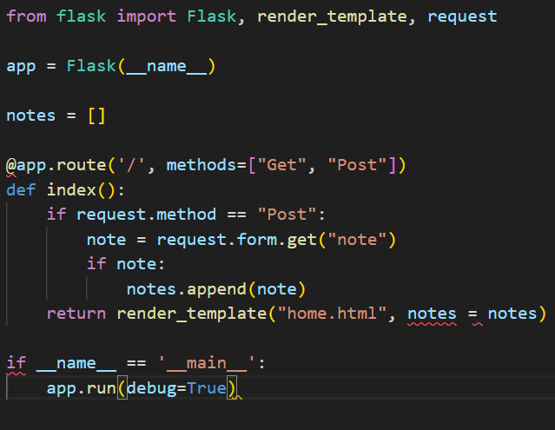
Flask & Html Final Code

Slide 6

Result :
Conclusion :
In conclusion, the Note Taking Application's Python, Flask, and HTML codebase underwent vital improvements and bug fixes to enhance functionality and security.
Issues with form submission, Flask routes, HTML form methods, and note retrieval were identified and resolved.
The final Flask and HTML code reflect these changes, resulting in a more polished and user-friendly Note Taking Application.

Slide 7


